Slide 1


Slide 2


Introduction
Walmart, one of the world’s largest retail corporations, operates numerous stores across various regions. Accurate sales forecasting is crucial for maintaining optimal inventory levels, ensuring customer satisfaction, and maximizing profits. The task of predicting sales becomes especially challenging during holiday seasons especially in the 5 markdowns, where sales spikes and patterns differ from regular weeks. This project seeks to leverage historical sales data to forecast future sales trends, helping Walmart make informed business decisions.

Slide 3
The data analysis process
Define the Objective / Problem Statement
Collect Data
Clean and Prepare Data
Exploratory Data Analysis
Interpret and Analyse Results
Generate Insights and Recommendations

Slide 4
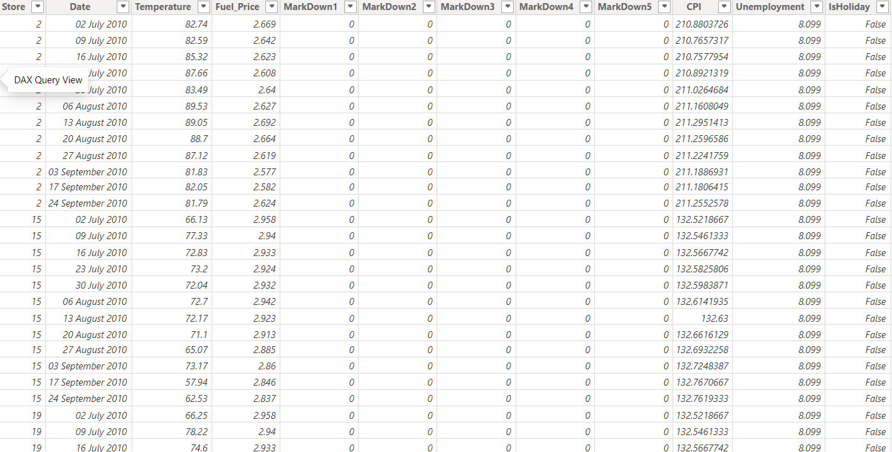
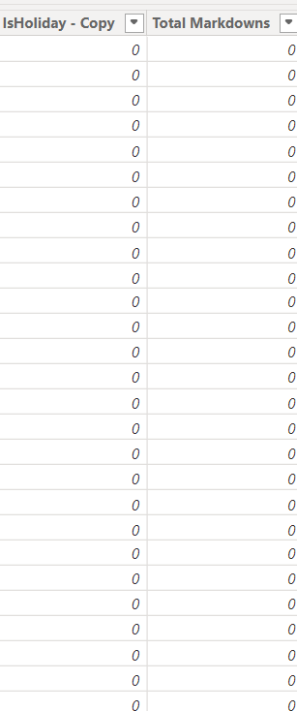
Clean and Prepare Data:
Cleaned dataset with the added columns(Excel):

Slide 5
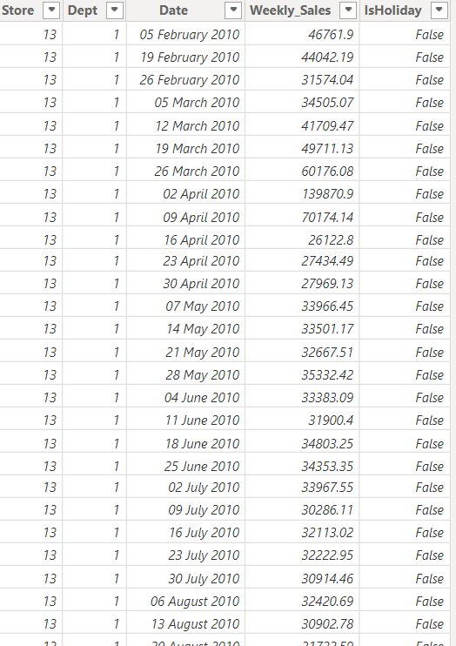
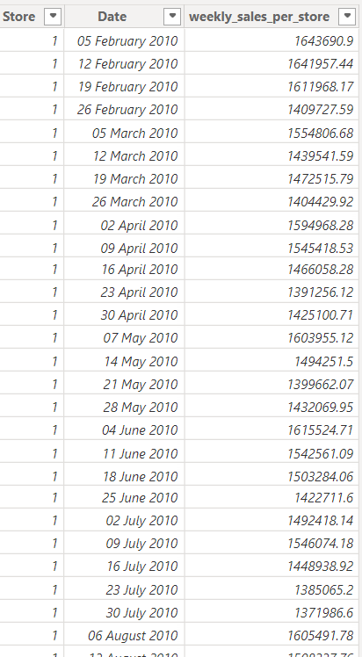
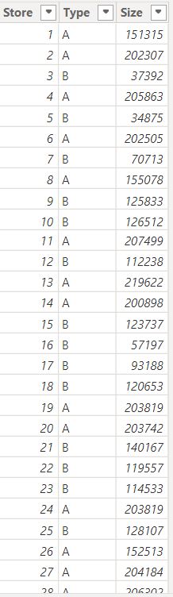

Slide 6
Added columns:
IsHoliday_Copy: replaced the values of false with 0 and true with 1.
Total markdowns: Sum of markdown 1 to markdown 5.
Weekly_sales_per_store: sum of weekly sales of all branches in the same store over each week.
Errors fixed:
missing values in the unemployment rate: getting the avg. of the rate for each store over all weeks and replace the missing values.
Missing values od markdowns: replacing it with zeroes.

Slide 7
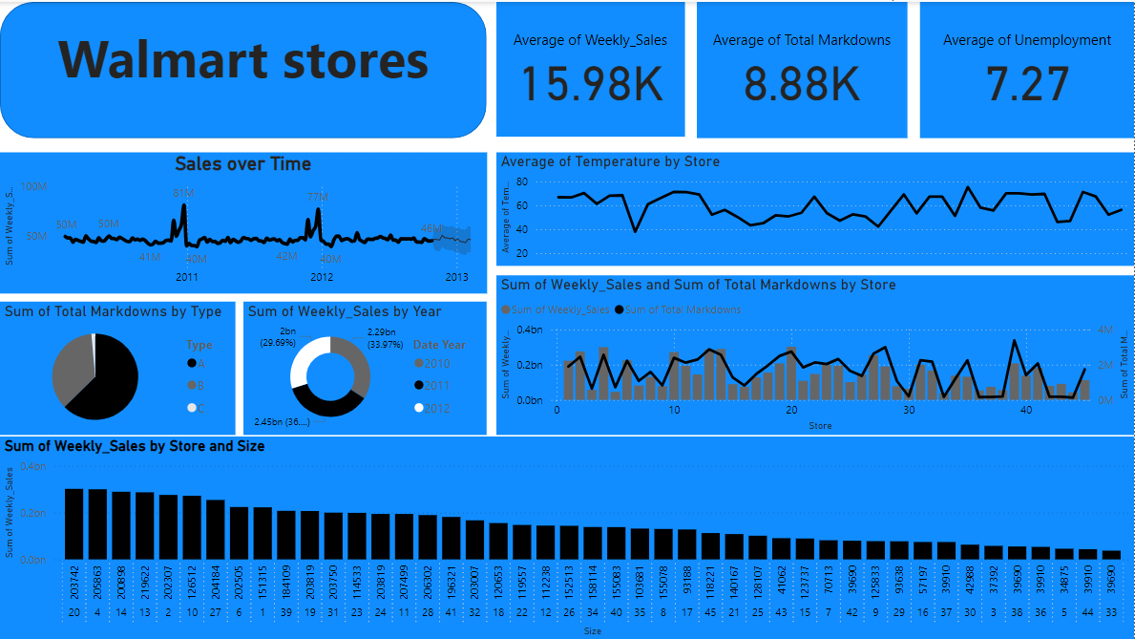
Analyzing the dataset(power bi):

Slide 8
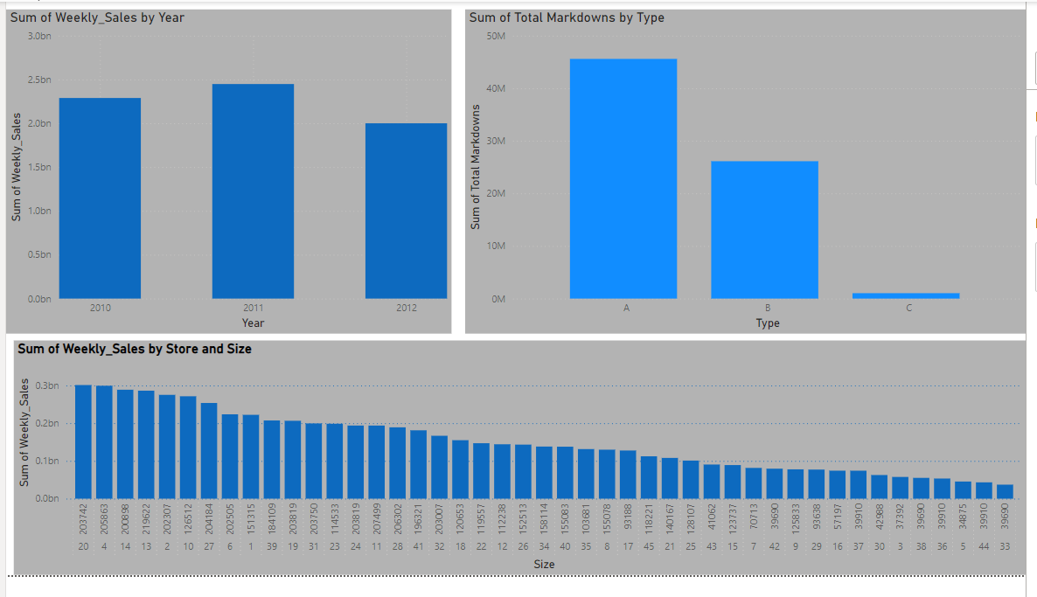
Insights:
A huge markdowns promotion in the A type especially , due to increase in demand and sales.
2012 was the least in sales due to increase in the B and C store type with decrease in the store size.
The larger the size of the store, the greater the sales are.

Slide 9
Recommendations:
Investigate 2011 Factors: Conduct a deeper analysis to identify the specific reasons for the exceptional sales performance in 2011.
Considering Type C Optimization: due to the decrease in sales we must optimize the C type and upgrade it to the A type
3.expanding existing stores or opening new ones in strategic locations.

Slide 10
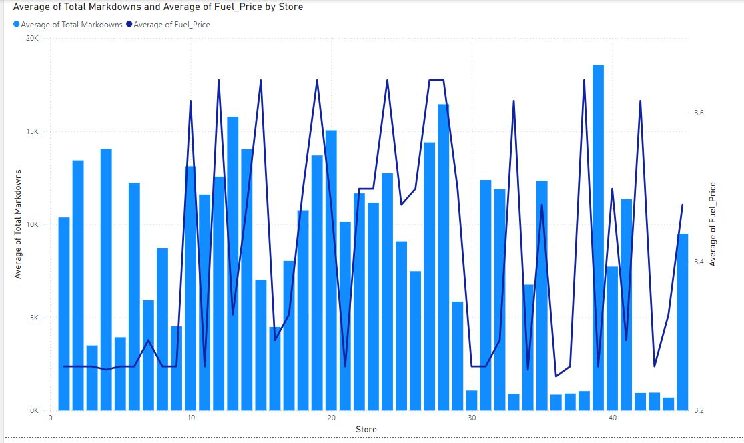
Insights:
A comparison between total markdowns promotion for each store with the avg. fuel price in the area .
As we see in the stores 33,38 there is a huge gab between fuel price and the promotions due to a bit stagnant these store.

Slide 11
Recommendations:
1-Fuel-Efficient Product Promotions: Focus on promoting products that are perceived as fuel-efficient or cost-saving. This could include energy-efficient appliances, eco-friendly products, or products that reduce transportation costs.
2-Bundle Offers: Create bundle offers that include fuel-related products or services, such as discounts on car maintenance or fuel cards.
3-Monitor Fuel Markets: Keep track of long-term fuel price trends and industry forecasts to anticipate future changes and adjust markdown strategies accordingly.

Slide 12
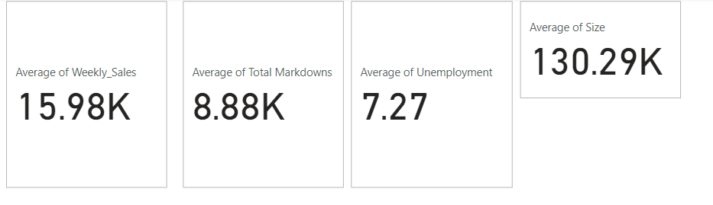
Insights:
-important KPI’s the illustrates and also affects the total performance of the stores

Slide 13
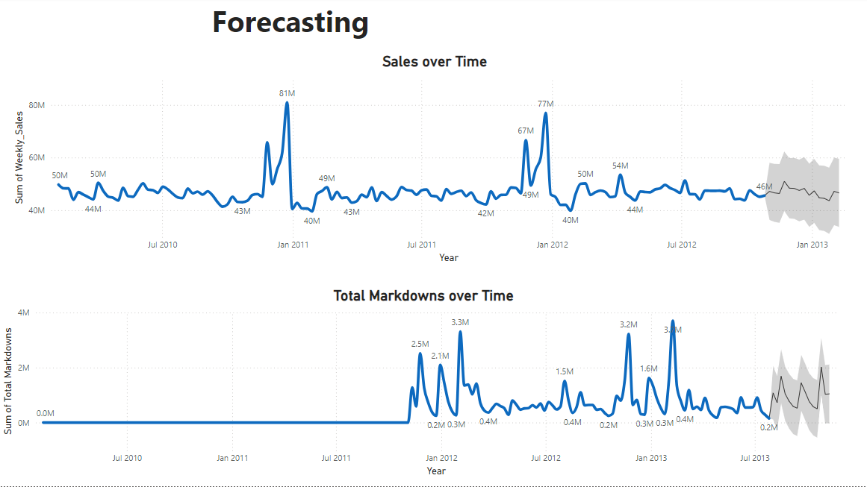

Slide 14
Recommendations
Inventory Management: Optimize inventory levels based on sales forecasts to avoid stockouts or excess inventory.
Customer Segmentation: Segment customers based on their purchasing behavior and preferences to tailor marketing efforts and product offerings.

Slide 15
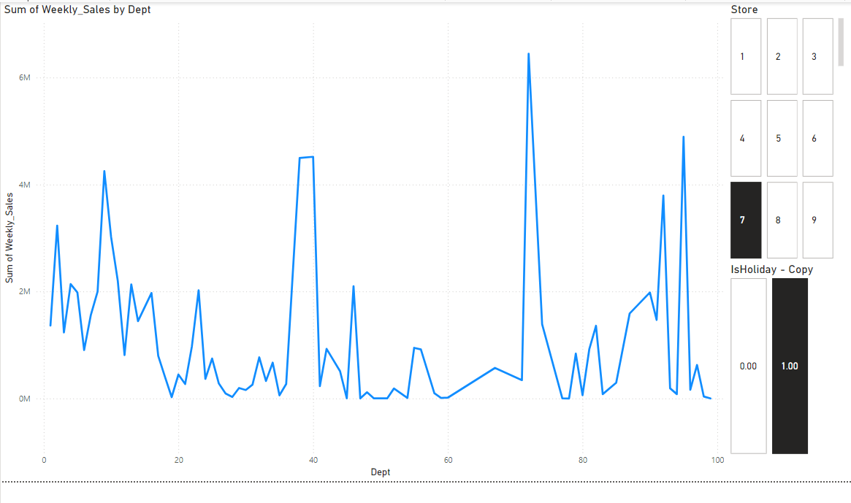
Insights:
Sum of weekly sales to department.
There are 2 filters to this visual : - store no. filter
- is this week a holiday or not

Slide 16
Recommendations:
Employee Training: Provide targeted training to employees in underperforming departments to enhance their product knowledge, sales skills, and customer service.
Marketing Initiatives: Develop department-specific marketing initiatives to promote products and attract customers. This could include targeted advertising, in-store promotions, or social media campaigns.

Slide 17
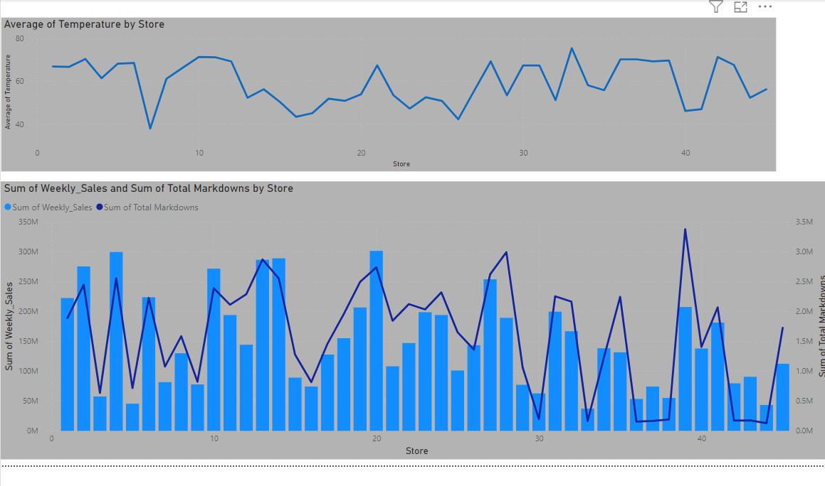
Insights:
One of the most important figures that shows a direct relation between temp and sales & promotions per store.
39,40 stores have a significantly low temp. which affect the sales directly although a huge promotions to product are being conducted .

Slide 18
Recommendations:
Temperature-Based Promotions: Develop targeted promotions based on temperature variations. For example, offer discounts on summer clothing and accessories in warmer regions or winter gear in colder areas.
Energy Efficiency Focus: Promote energy-efficient products and services, especially in regions with extreme temperatures. This could help attract environmentally conscious customers and reduce operating costs.
Seasonal Inventory Planning: Optimize inventory levels based on seasonal temperature trends. This will help ensure adequate product availability and avoid stockouts or excess inventory.

Slide 19
Our team:
Alhassan Shereif Ibrahim
Mostafa Mansour
Youssef Omran
Peter hany

Slide 20
Thank you

